Slide 1
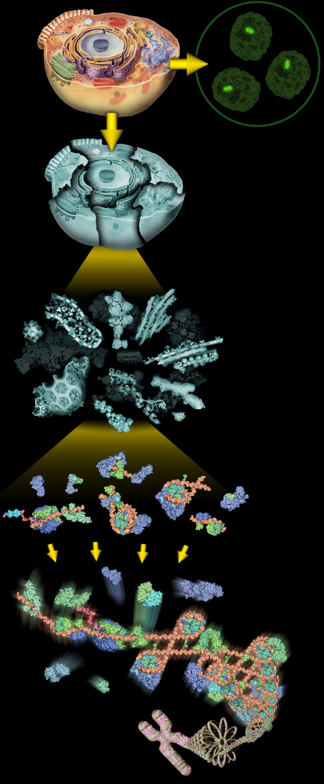
Proteomics Informatics
3 Credits
Course Director:
David Fenyö

Slide 2
Proteomics Informatics
Learning objective:
Understanding of methods for analysis of proteomic data

Slide 3
Proteomics Informatics
Syllabus
Week 1 Overview of proteomics
Week 2 Overview of mass spectrometry
Week 3 Analysis of mass spectra: signal processing, peak finding, and isotope clusters
Week 4 Protein identification I: searching protein sequence collections and significance testing
Week 5 Protein identification II: de novo sequencing
Week 6 Databases, data repositories and standardization
Week 7 Proteogenomics
Week 8 Protein quantitation I: Overview
Week 9 Protein quantitation II: Targeted
Week 10 Protein characterization I: post-translational modifications
Week 11 Protein characterization II: Protein interactions
Week 12 Molecular Signatures
Week 13 Presentations of projects

